Slide 1
Dynamic Traffic Light Control
Guide :Prof. P. M. Bagul.
Domain : Embedded Systems, IoT

Slide 2
Abstract
In recent era, due to the increase in population and the number of vehicles bought, there is a problem of congestion of traffic in the major cities around the globe. This not only increases the time delay but also increases the fuel consumption and air and noise pollution. It is observed that conventional traffic flow is intricate and non predictable. Furthermore emergency vehicles like ambulances, fire trucks etc. are delayed. This project aims to solve the aforementioned problems by implementing real time control of the traffic signals using Image Processing, IoT and Object Detection. Embedded Systems are small and can be integrated with the existing infrastructure in order to reduce the cost and complexity.

Slide 3
Introduction
Unfortunately, in recent times the increasing number of vehicles can cause a series of economical as well and social problems.
However due to limited availability of land, the roads cannot be widened to suit the traffic needs.
Conventional traffic light systems use a fixed cycle of pre-defined pattern to control the dynamically changing traffic flow.
Dynamic Traffic Light Control refers to the control of flow of traffic via the signals in real-time.

Slide 4
Problem Statement
The purpose of this project is to develop a system that will solve the issue of excess traffic on a particular signal as well as have total synchronization between all the signals in a particular area. Additionally there is a problem for the emergency vehicles of not being able to pass through the signal without the presence of a traffic cop.

Slide 5
Survey
In our personal interview with the DCP of Traffic, Mr. Pankaj Deshmukh, mentioned that currently there is a huge lack in infrastructure in our city.
The road and signal infrastructure is not able to cope up with the rapid growth in number of cars.
Wrote a paper on the different types of systems currently implemented.
Different Systems like Fuzzy Logic, Image Processing, Wireless Sensor Network, Dynamic Programming and IR sensor with IoT were studied.

Slide 6
Motivation
It commonly occurs that, at a particular intersection there is high density of traffic in one lane and there is very low density of traffic in the others. Despite that, the green time for all the lanes are the same.
Another major problem is the excess waiting time for emergency vehicles. Due to the Static nature of current system, there is no easy way to detect emergency vehicles.

Slide 7
Proposed Work
In order to reduce the waiting time at a signal, we are proposing the use of Dynamic Traffic Light control with the help of Image Processing, IoT and Object Detection.
The major data will be collected from the existing CCTV cameras.
With the help of the data from the CCTV cameras, Emergency vehicles also will be detected.
With the help of this system, there will be no waiting time for Emergency vehicles.
There will be intercommunication between signals at adjacent intersections as well as between the signals at an intersection in order to have a full interconnection and synchronization in the system.

Slide 8
Methodology
We will be calculating the traffic density with the help of the current CCTV footage which will be supported by TomTom maps traffic data.
The communication between two signals will be done with the help of ESP8266 Node MCU.
We will then obtain the traffic density in each lane.
Whichever lane will have highest traffic density will be given priority over other lanes and its signal will be made green.
At the same time the traffic signals at an intersection will be interacting/communicating with each other so as to know the amount of traffic coming its way.
Based on all this data which signal has to be made green next is decided.

Slide 9
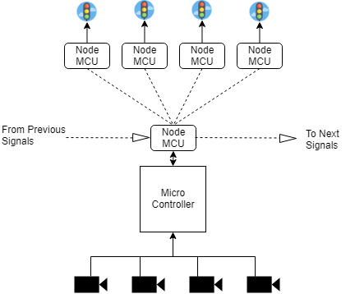
Block Diagram

Slide 10
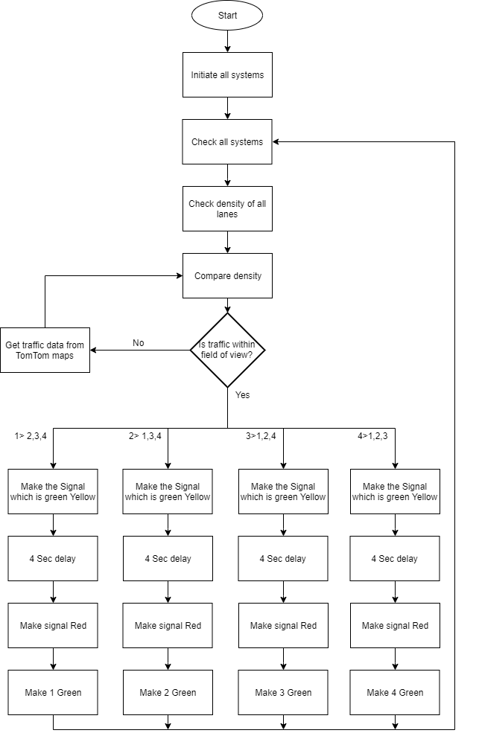
Flow Chart

Slide 11
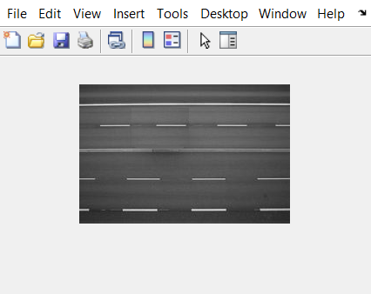


Mini Project - Concept

Slide 12
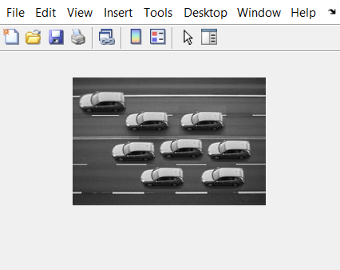
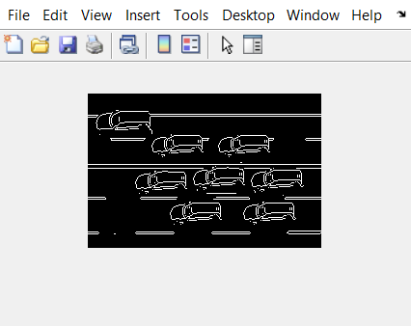
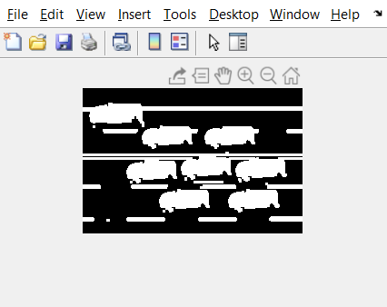
Image Processing for Static Data

Slide 13
Object Detection and Recognition
Using the CCTV cameras the density of traffic will be measured.
The AI model used for Object Detection and Recognition is an SSD (Single-Shot Detection model)
The Region of Interest is defined for each lane to avoid detection of vehicles outside the lane but in the frame of the camera.

Slide 14
Comparisons

Slide 15
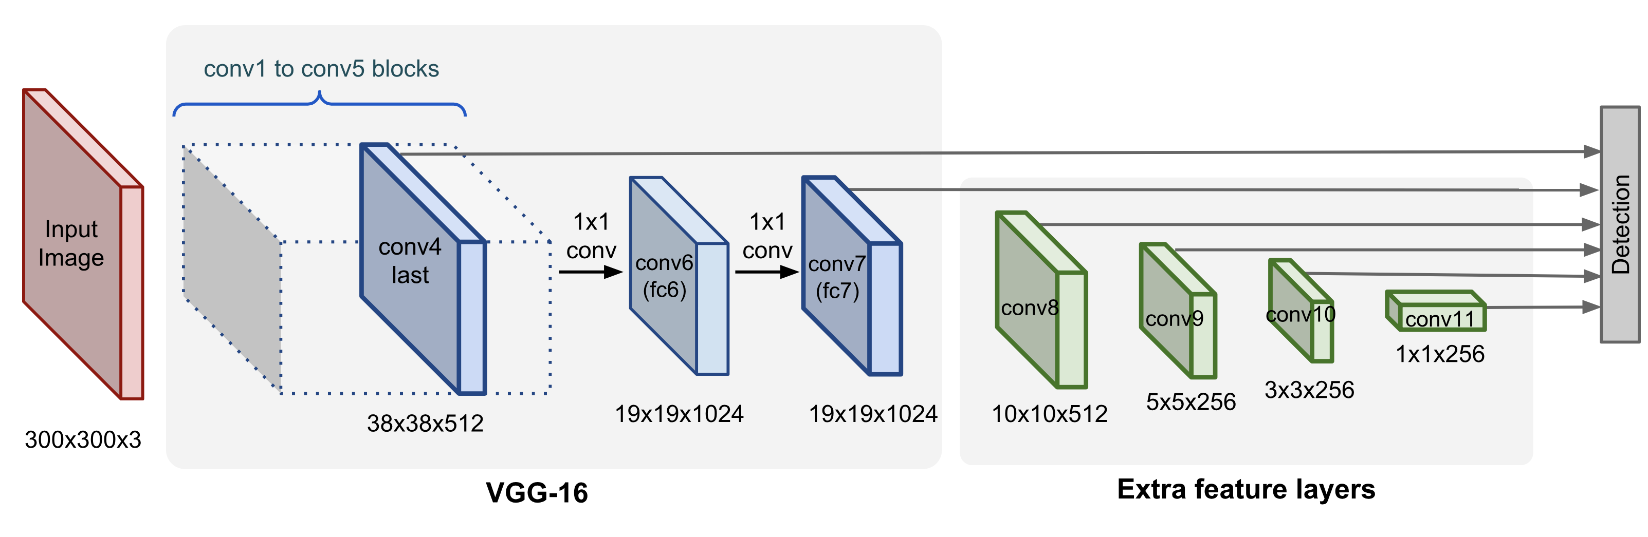
Block Diagram of SSD model

Slide 16
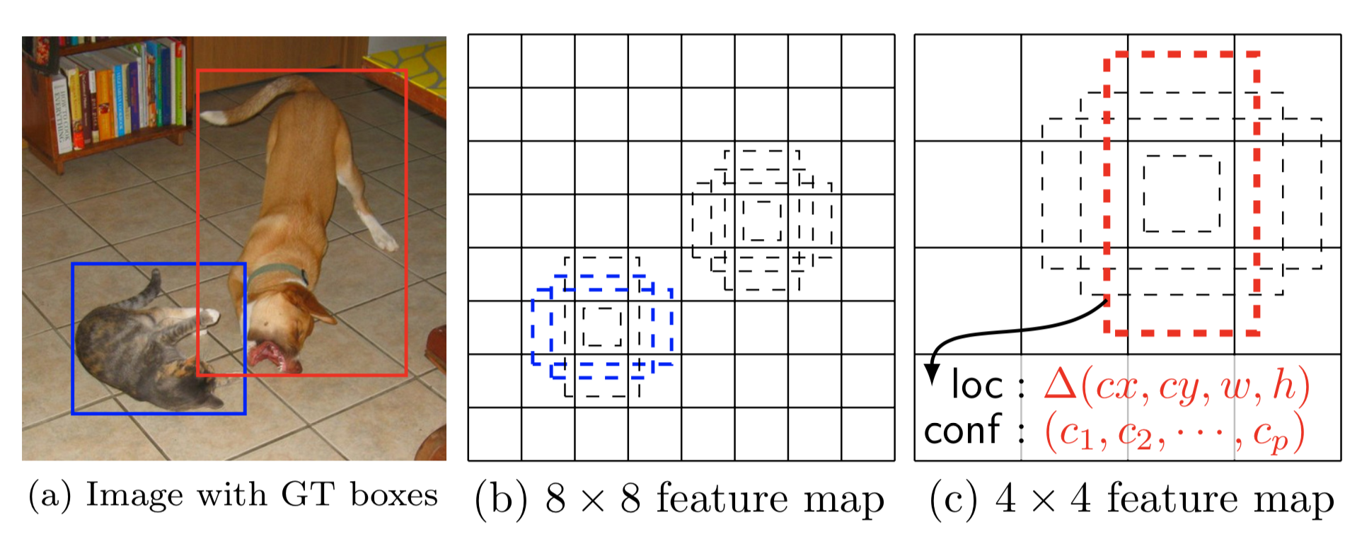
Working of SSD model

Slide 17
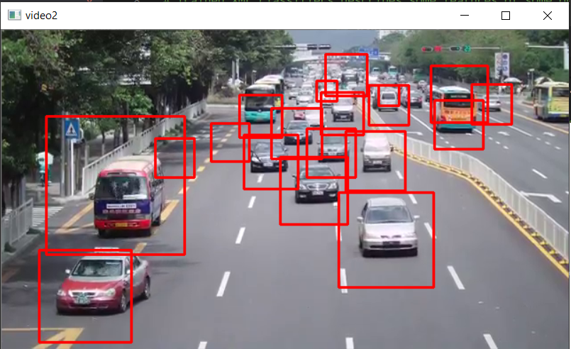
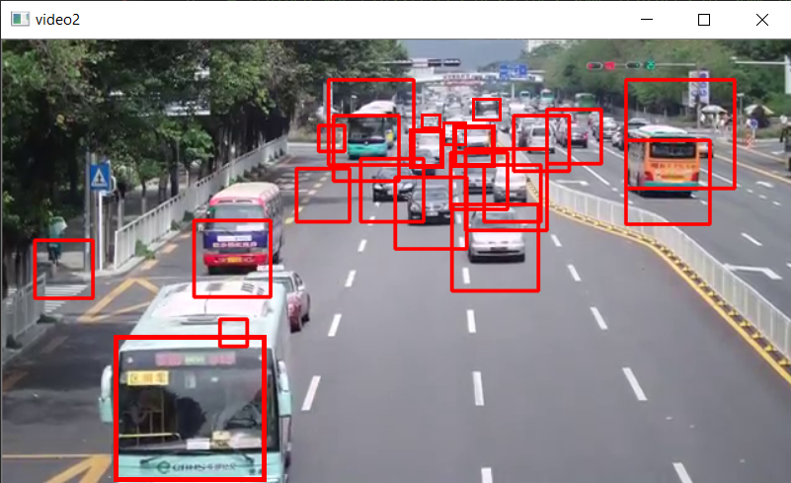
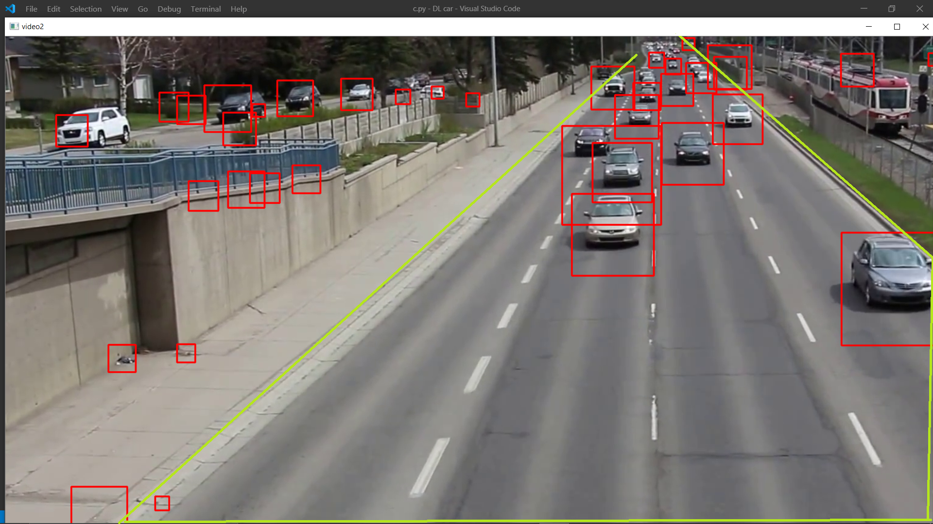

Slide 18
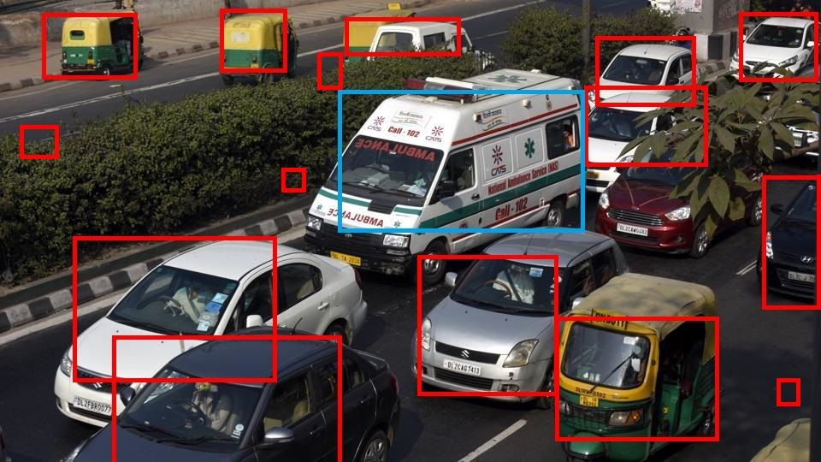
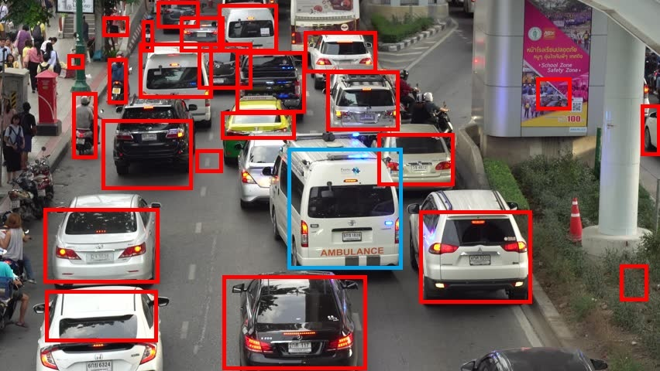
Emergency Vehicles
In order to detect and recognize emergency vehicles, the SSD model is trained on the ImageNet database.

Slide 19
Communication
The communication between signals at a particular road intersection is called Intra-communication while the transfer of data between signals at different road intersections is called Inter-communication.
To achieve this, NodeMCU, a Wi-Fi module is used.
The data from the CCTV footage will be stored on Google Firebase database.
This data can be accessed by all the NodeMCU which will then compute which lane to let go based on the data from the adjacent intersection as well as the data from TomTom Maps.

Slide 20
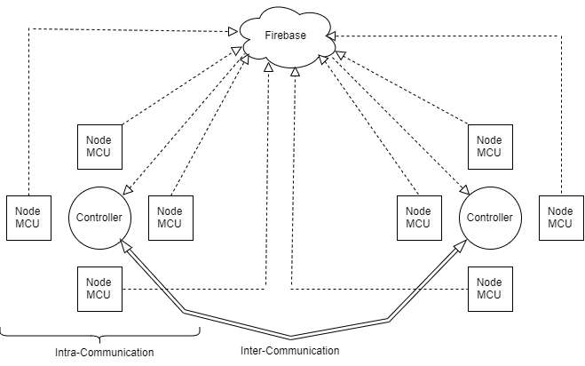
Block Diagram of Communication

Slide 21
TomTom Maps
TomTom Maps are used to support the data from the CCTV cameras.
The data is received through the Traffic API.
The traffic API requires the input as :
/traffic/services/{versionNumber}/flowSegmetData/{style}/{zoom}/{format}/{point}
Where, versionNumber : Latest version Number of the API.
style : Absolute, Relative or Relative-delay.
zoom : To determine the two sides of the road.
format : xml, json or jsonp
point : Co-ordinates of the lane.
Unit : unit of Speed – KMPH or MPH (optional)

Slide 22
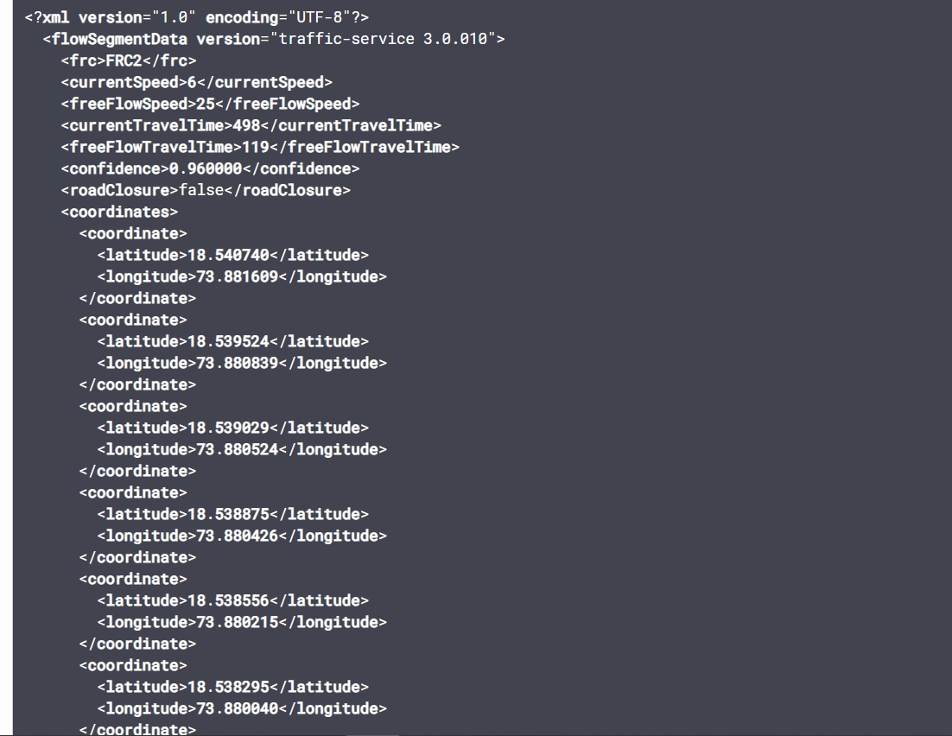
Output of TomTom maps

Slide 23
Expected Outcome
By implementing this system we expect the following:
Reduction in congestion of vehicles.
Less delay in reaching a destination.
More priority to emergency vehicles.
Reduction in Pollution.

Slide 24
References
Dynamic Traffic Light Control Systems - A Survey.
Paper Comparing the Different types of Currently implemented Solutions for Dynamic Traffic Light Control.
https://lilianweng.github.io/lil-log/2018/12/27/object-detection-part-4.html
CHEN Wenjie, CHEN Lifeng, CHEN Zhanglong, TU Shilian, “A realtime Dynamic Traffic Control System”, 2005
Yi Tian, Dongbin Zhao, and Jianqiang Yi, “A Fuzzy Logic Controller with Adaptive Dynamic Programming Optimization for Traffic Signals”, 2008
Wei Wu and Wang Mingjun, “Research on Traffic Signal Control Based on Intelligence Techniques”
Lilin Zang, Yonggang Luo and Lei Jia, "An Intelligent Control Method for Urban Traffic Signal Based on Fuzzy Neural Network", 2006
Md. Fahim Chowdhury, Md. Ryad Ahmed Biplob, Jia Uddin, "Real Time Traffic Density Measurement using Computer Vision and Dynamic Traffic Control", 2018

Slide 25
Thank You

